Slide 1

Lecture 2
Texts and Links
Notes:
Welcome to this M1 in SQL Course. In this first chapter of the course, we are going to do an introduction of databases and relational databases.

Slide 2

A G E N D A
Texts in HTML: Paragraphs, Headings & Comments
Links

Slide 3
Paragraphs / Headings / Comments
Notes:
Without further adieu, Let’s look at the course introduction so that you will know what you are going to learn.

Slide 4

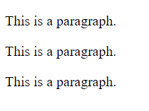
Paragraphs
A paragraph is denoted by the <p> tag
<p>This is a paragraph.</p>
<p>This is a paragraph.</p>
<p>This is a paragraph.</p>
Paragraph tags ignore any type of extra spaces
<p>
This paragraph contains a lot of spaces
in the source code
</p>

Slide 5
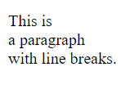
Line Breaks
We can see that extra spaces do not work for paragraphs. So how can we start a new line within a paragraph? That is where <br> tags come in handy.
<p>This is<br>a paragraph<br>with line breaks.</p>

Slide 6
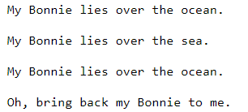
Preformatted Text
What if we have multiple lines and we do not want to add <br> all the time?
That is where <pre> tags come in handy.
<pre>
My Bonnie lies over the ocean.
My Bonnie lies over the sea.
My Bonnie lies over the ocean.
Oh, bring back my Bonnie to me.
</pre>

Slide 7
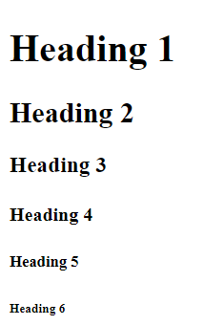
Headings
A heading is denoted by the <h1>,<h2>,.. tags
<h1>Heading 1</h1>
<h2>Heading 2</h2>
<h3>Heading 3</h3>
<h4>Heading 4</h4>
<h5>Heading 5</h5>
<h6>Heading 6</h6>
We can notice that the size of headings decrease as the tags increase from h1,h2,h3,....h6. There are no headings beyond h6.

Slide 8
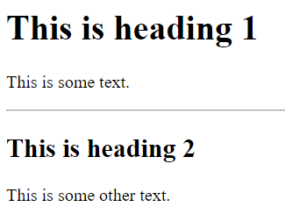
Horizontal Lines / Dividers
The <hr> tag is used to separate vertical content by drawing horizontal lines on our HTML.
<h1>This is heading 1</h1>
<p>This is some text.</p>
<hr>
<h2>This is heading 2</h2>
<p>This is some other text.</p>

Slide 9

Comments
Comments help us to document our code for better readability
<!-- This is a comment -->
<p>This is a paragraph.</p>
<!-- Comments are not displayed in the browser -->
Notice that there is an exclamation point in the starting tag but not the ending one. Any text written between these two tags will be considered as a comment and will not appear in our webpage.

Slide 10
Links
Notes:
Without further adieu, Let’s look at the course introduction so that you will know what you are going to learn.

Slide 11

Links
Links are common across most web pages. They allow users to navigate from page to page
When we hover over a link, the cursor turns into a little hand
<a href="url">link text</a>
<a> | the tag used to define hyperlinks
href="url" | the most important attribute of <a> tags. It defines the destination of the link.
link text | the text that will appear on the link. If we click on this text, we will be redirected to "url"

Slide 12
In-class Exercise
Let us try to predict the html code for the following
link below: (it will take us to google.com)
Take me to Google!
Pause the video, take a minute to study the previous slide, and think about how to create the link to google.com above!

Slide 13
In-class Exercise
Let us try to predict the html code for the following
link below: (it will take us to google.com)
Take me to Google!
Solution:
<a href="https://www.google.com/">Take me to Google!</a>

Slide 14
Other Attributes
target="_blank"
Often times, we might want to open the link in a new tab. Adding the target=”blank” attribute does the trick.
<a href="https://www.google.com/" target="_blank">Take me to Google!</a>

Slide 15
Other Attributes
mailto:
We can link a piece of text with someone’s email address in order to send emails more swiftly!
<a href="mailto:someone@example.com">Send Email!</a>

Slide 16

That’s all for this module!
THANK YOU

